Slide 1
Create LAMP Server using Ansible
Sitesh Bade

Slide 2
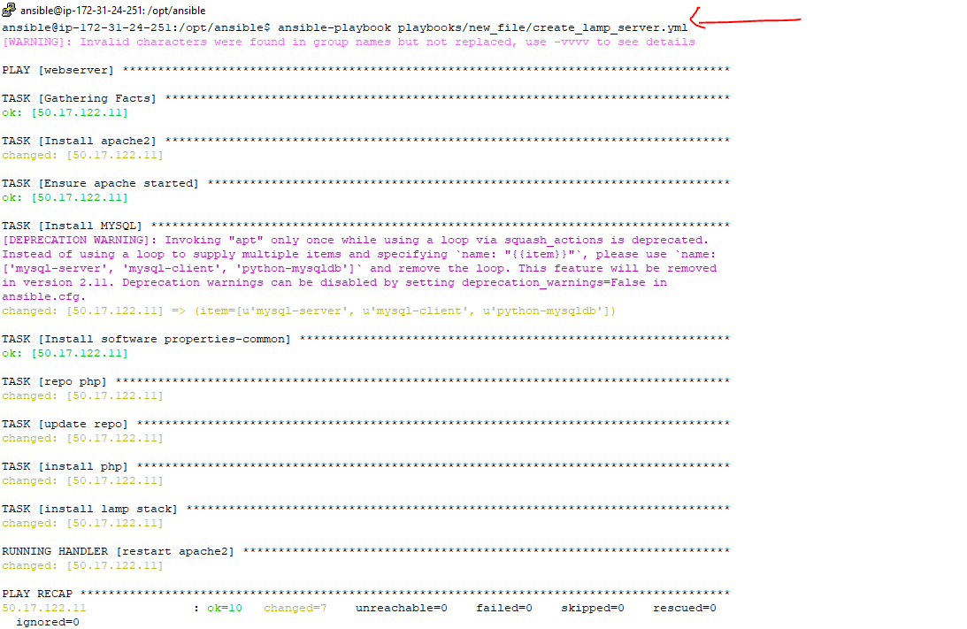
Playbook- LAMP Server [Linux,Apache,Mysql &PHP)
Get the playbook from github repo: https://github.com/siteshbade/Ansible_LAMP_playbook.git
Run ansible playbook

Slide 3
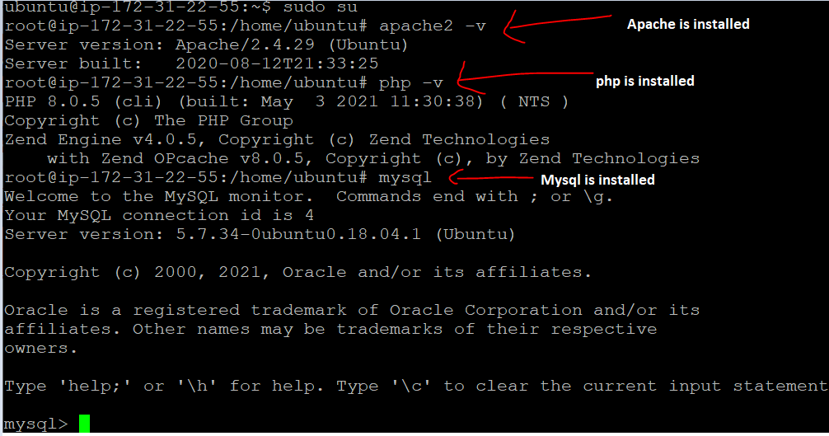
On client/host : validate whether LAMP is installed

Slide 4
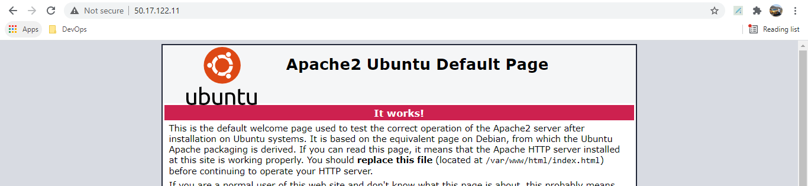
Apache is accessible using server ip

